Slide 1
Total Life Manager
Stephen Johnson, Logan Grisham, Sebastian Hardesty

Slide 2
Outline
Introduction
Technology
Deployment
Original Concept
Challenges
Design
Known Bugs
Future Work
Outro

Slide 3
Introduction
Total Life manager
Website for storing and analyzing fitness and health data.
Core features:
Data visualization
Goal setting
Fitness and health analysis
Ancillary tools for betterment

Slide 4
Technology
Platform:
Firefox
Operating System:
Windows 10
Languages:
HTML, CSS, Javascript, PHP, MySQL
Libraries:
Chart.js

Slide 5
Deployment
Linode server
Ubuntu 20.04
LAMP stack
MySQL

Slide 6
Original Concept
Fitness
The Design stemmed from just fitness goals
Calories, Exercise, Water
Shifted towards total health
Sleep, height, weight
More pages
Additional content, removed for time
Trend analysis
Difficult to determine rational results

Slide 7
Challenges
Graphs
Chart.js
Dashboard
Widgets, API’s, style
Backend
PHP, MySQL updates

Slide 8
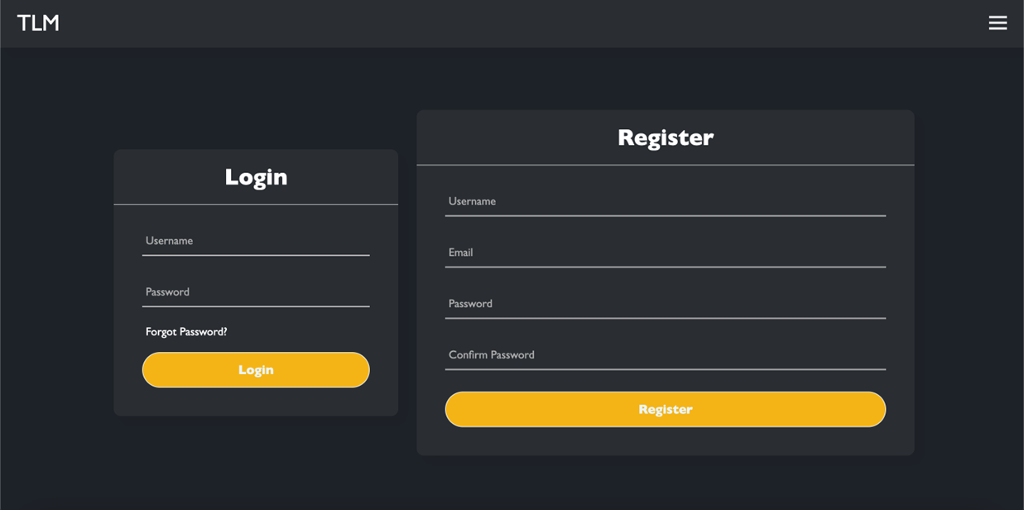
Design
Login and Register system
Originally Disjoint
Hashed and salted for your safety

Slide 9
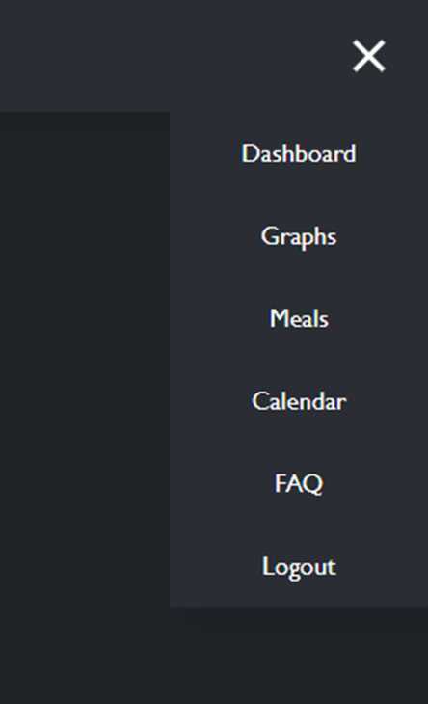
Design Cont.
Generally, a collection of webpages
The site is centralized to the dashboard
Widgets: Graphs, Data Rings, Weather
Hamburger Menu navigation
Transforms, linking, logged-in status

Slide 10
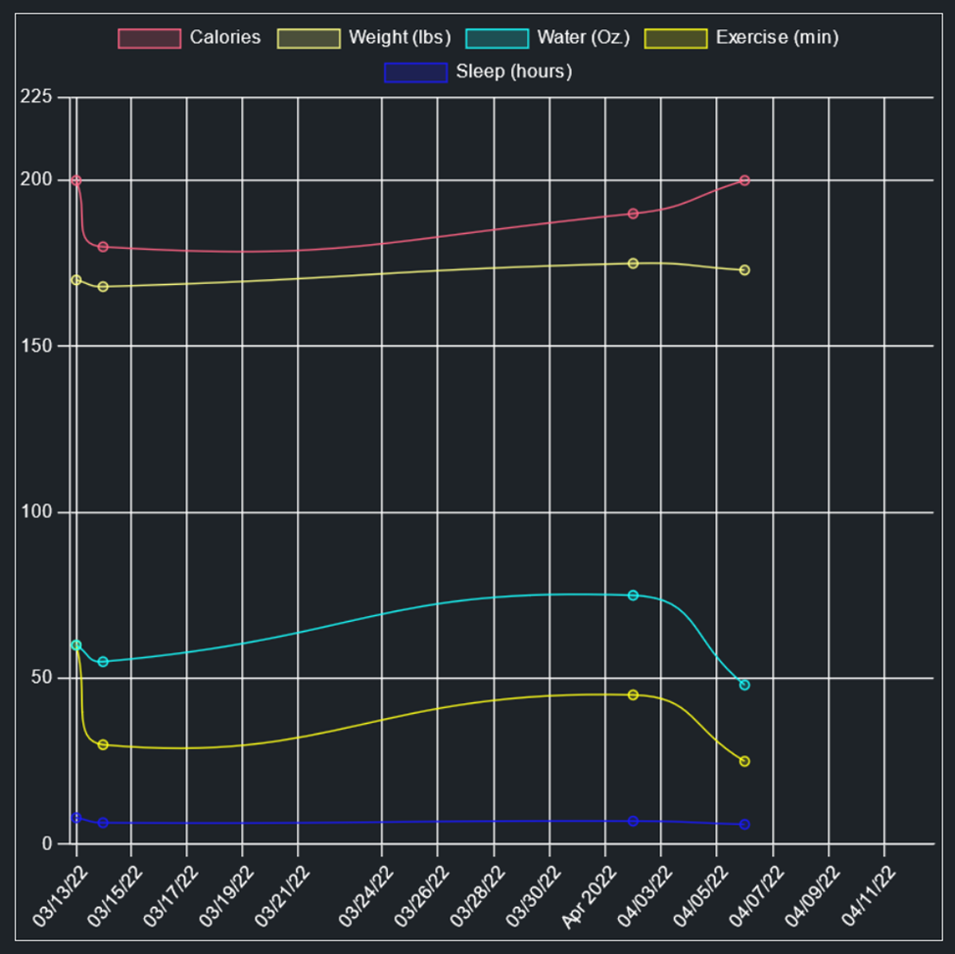
Design Cont.
Graphs
Separate toggleable categories
Pulls all user data
Graph widget
Compact view

Slide 11
Known bugs
Graphs:
Negative Values
Divs pushing together when the screen shrinks
Registration.php
No longer disjoint from Login.php
Both processes exist on Login.php now, could cause security issues in the future

Slide 12
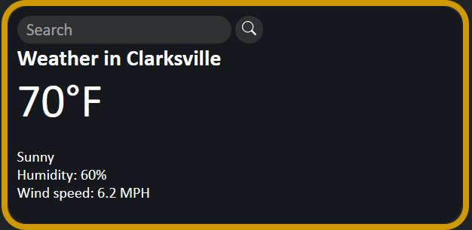
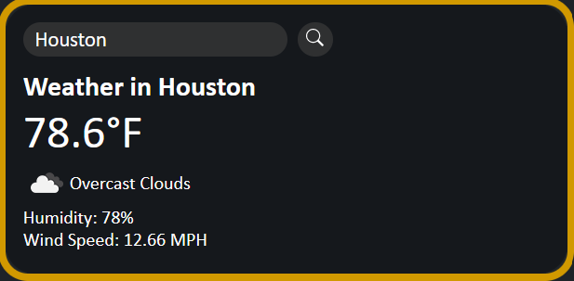
Future Work
Cut content
Meals page
USDA API
Landing Page
FAQ and Support page
Planned ahead
Weather API location detection
Account changes
Adjust Circle Widget Implementation
Complete Calendar Widget and Page
Refactor and Reduce Code “Smell”
Mobile support through the web

Slide 13
Outro
What TLM has taught us
Working as a team (Using GitHub, communicating ideas for changes, splitting responsibility)
Meeting deadlines
Limiting scope
Brainstorming and problem-solving
Working around unforeseen life events
What could have gone differently
Better time management
Cutting fluff features sooner
Leveling out feature weight
The site is heavily impinged on the dashboard and graphs

